Slide 1
What is Accessibility ?
Make differently abled to digitally enabled

Slide 2
Agenda
What is Accessibility ?
Examples of Accessibility
Types of Disabilities
Accessibility Statistics
Assistive Technologies
Accessibility Compliance Laws
Case Studies of Accessibilities
Accessibility Principles
Accessibility Guidelines
Key Technologies

Slide 3
What is Accessibility ?
Accessibility in the sense considered here refers to the design of products, devices, services, or environments so as to be usable by people with disabilities
Accessibility is strongly related to universal design which is the process of creating products that are usable by people with the widest possible range of abilities, operating within the widest possible range of situations
Accessibility can be viewed as the "ability to access" and benefit from some system
Accessibility can be implemented in software’s, houses, malls, roads, transportation, in daily use objects

Slide 4
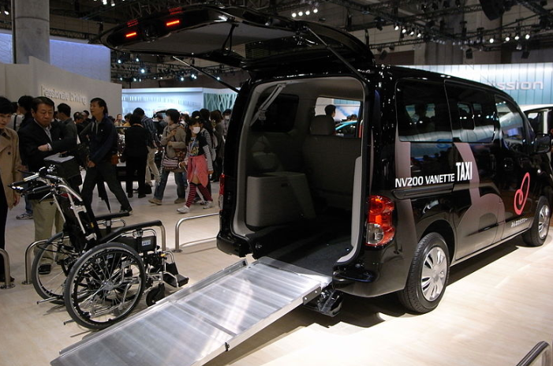
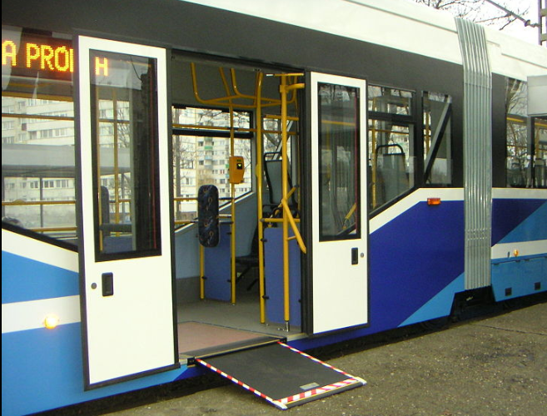
Examples of Accessibility
A wheelchair accessible taxi with a rear ramp
A retractable wheelchair-access ramp in tram

Slide 5
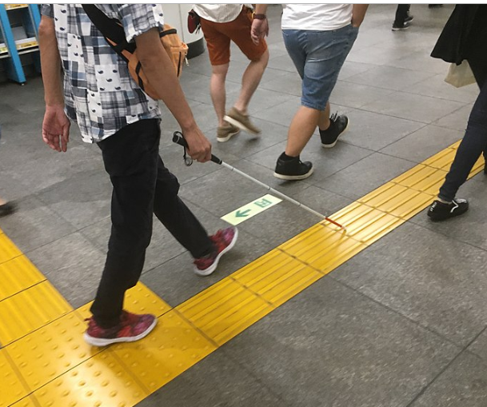

Examples of Accessibility
Tactile paving can assist the visually impaired as they walk
The ridges found on the F and J buttons on a computer keyboard are designed to help users locate the correct keys (Universal and Inclusive Design)

Slide 6
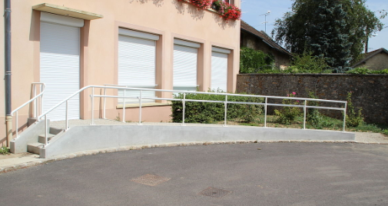
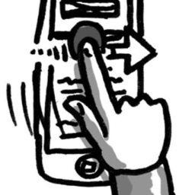
Examples of Accessibility
Architectural design for both normal and wheel chair user (Universal and Inclusive Design)
Mobile, Tablets, Web applications are made accessible to reach disable community (Universal and Inclusive Design)

Slide 7
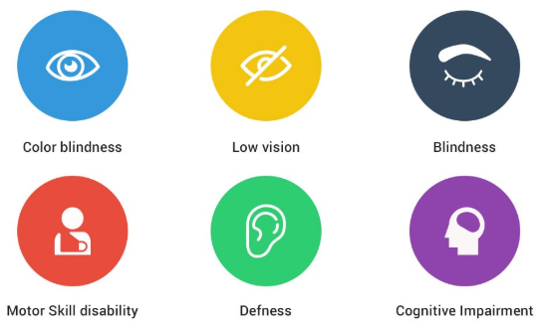
Types of Disabilities

Slide 8
Accessibility Statistics
About 15% of the world's population lives with some form of disability, of whom 2-4% experience significant difficulties in functioning
The number of people with disabilities is growing. This is because populations are ageing – older people have a higher risk of disability. Aging and Disability are linked
785 million (15.6%) persons 15 years and older live with a disability

Slide 9
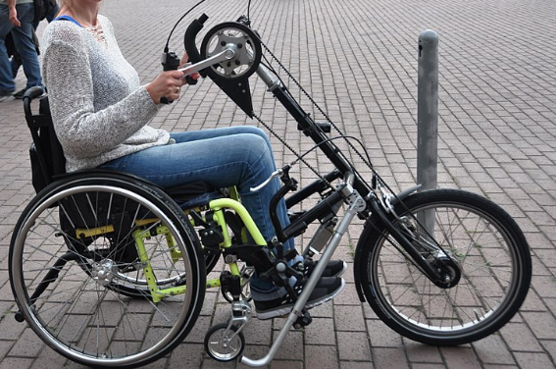
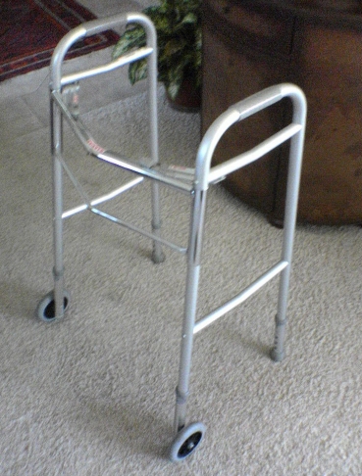
Assistive Technologies
Assistive technology (AT) is assistive, adaptive, and rehabilitative devices for people with disabilities or the elderly population
Mobility impairments
Wheelchair
Front Wheel Walker

Slide 10

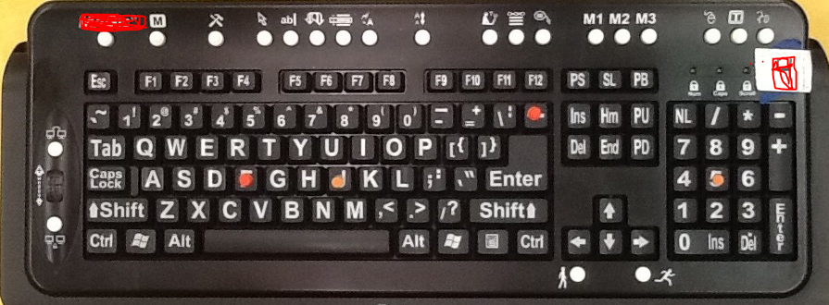
Assistive Technologies
Visual impairments
Braille is a system of raised dots representing letters, numbers, punctuation, and words
This large-print keyboard has tactile elements and special keys for the visually impaired

Slide 11

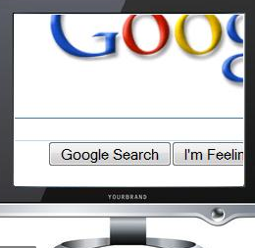
Assistive Technologies
Screen Readers: Commercial (JAWS) and Open Source (NVDA)
Screen Magnifiers

Slide 12
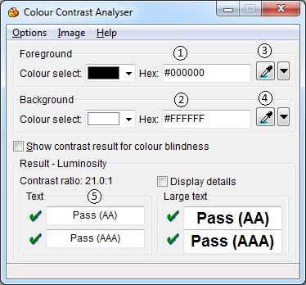
Assistive Technologies
Color Contrast Analyser

Slide 13




Assistive Technologies
NVDA: free, Windows
www.nvda-project.org
Window-Eyes: free trial version
www.gwmicro.com
JAWS: free trial version
www.freedomscientific.com
Voice Over: included on Mac and iOS
www.apple.com/accessibility/voiceover/

Slide 14

Accessibility Compliance Law
Canadian Human Rights Act
AODA
European Union: EN 301 549:
ADA
US Section 508
UK-Equality Act
China – Law of Protection for PWD
India – National Policy for PWD
Singapore – Enabling Masterplan
Australia – Disability Discrimination Act

Slide 15
Case Studies of Accessibility
Tesco Access Site - 35 thousand pounds to build, 13 million pounds a year in resultant revenue (2004, UK)
Legal & General - achieved 50% more natural search visitors and many more conversions after accessibility improvements (2007, UK)
CNET - Reported 30% increase in CNET traffic from Google after they started providing transcripts. We saw a significant increase in SEO referrals when we launched an HTML version of our site, the major component of which was our transcripts. - Justin Eckhouse, CNET, 2009
Sydney Olympic Games - required to pay 20 thousand dollars in damages due to poor accessibility (2000, Australia)
Target Corporation - paid 6 million dollars in damages after action by US National Federation for the Blind (2008, USA)
Amex - America Express hit the headlines after excluding visually impaired customers due to making its statements less accessible in a format change (2008, UK)

Slide 16
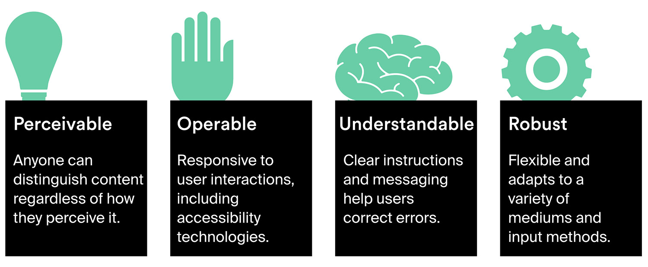
Accessibility Principles

Slide 17
Accessibility Guidelines
WCAG 2.0 was published on 11 December 2008

Slide 18
Accessibility Guidelines
WCAG 2.1 became a W3C Recommendation on 5 June 2018

Slide 19


Key Technologies
ARIA

Slide 20
References
https://en.wikipedia.org/wiki/Accessibility
https://www.google.com/image
https://www.who.int/disabilities/world_report/2011/report/en/
https://en.wikipedia.org/wiki/Assistive_technology
https://www.w3.org/WAI/EO/Drafts/bcase/resources
https://www.w3.org/WAI/

Slide 21
Thank You!
For any queries connect me at jatinkochhar@hotmail.com

